Slide 1
NLP

Slide 2
Word embedding

Slide 3
One hot encoding is bad
Large vocabulary means large vector
Do not capture meaning

Slide 4
Count-based methods

Slide 5
Word2Vec
Word2Vec is a model whose parameters are word vectors. These parameters are optimized iteratively for a certain objective. The objective forces word vectors to "know" contexts a word can appear in: the vectors are trained to predict possible contexts of the corresponding words. As you remember from the distributional hypothesis, if vectors "know" about contexts, they "know" word meaning.
Skip gram
CBOW

Slide 6
Skip gram model
take a huge text corpus;
go over the text with a sliding window, moving one word at a time. At each step, there is a central word and context words (other words in this window);
for the central word, compute probabilities of context words;
adjust the vectors to increase these probabilities.

Slide 7
GloVe

Slide 8
Transformer (Attention is all you need)

Slide 9
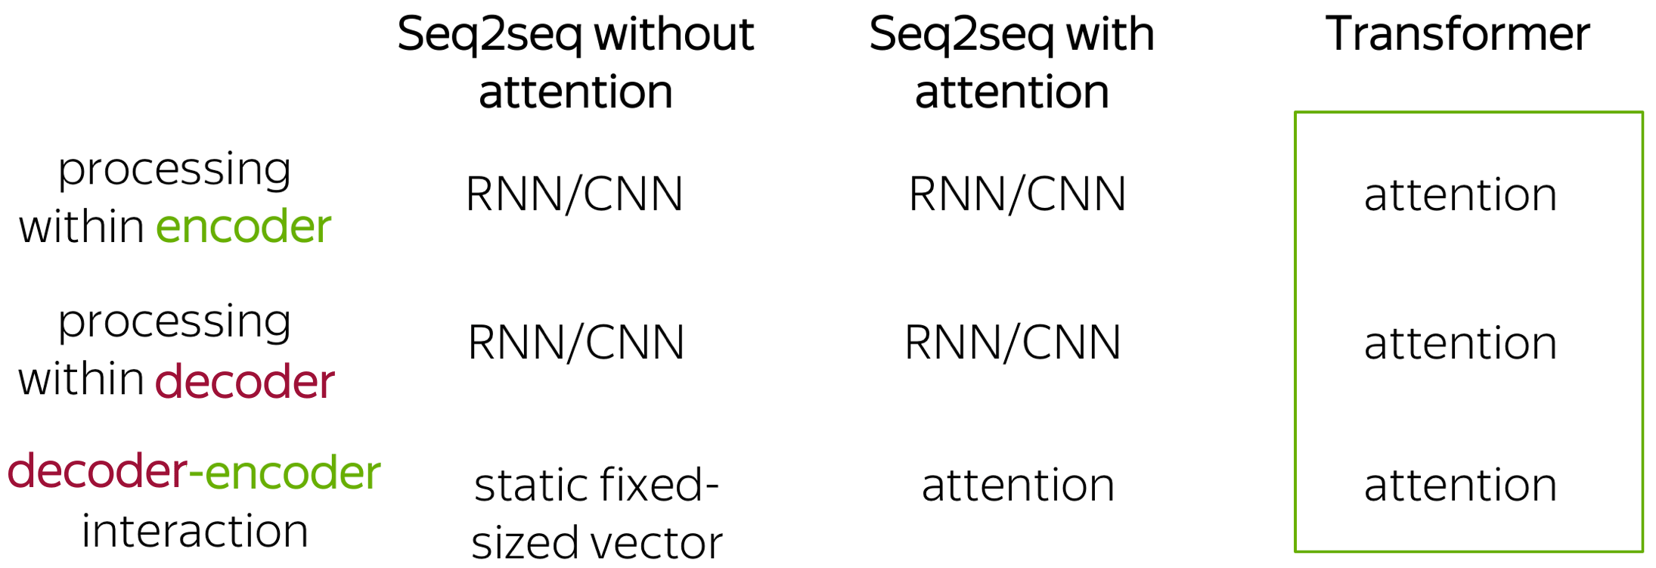
What’s new in transformer

Slide 10
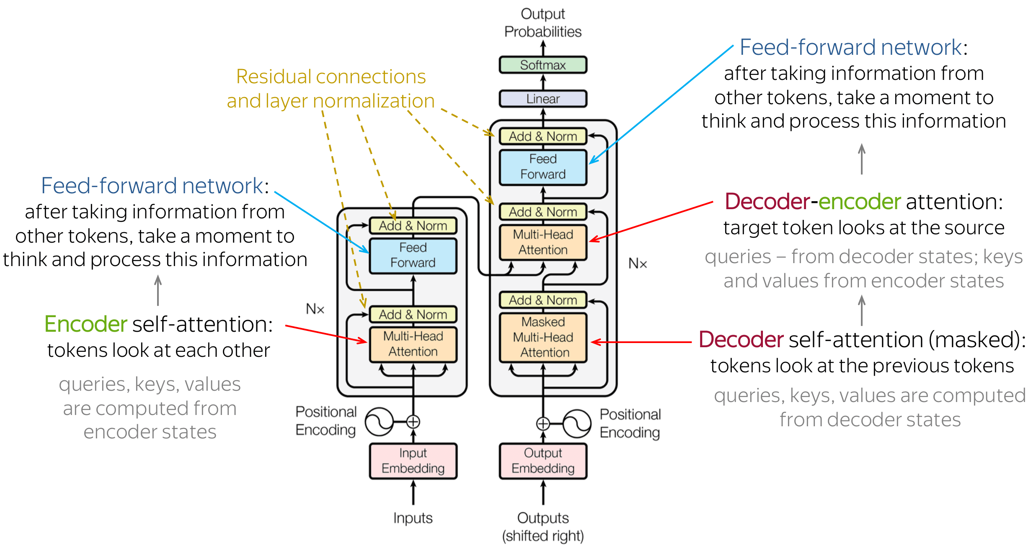
Architecture

Slide 11
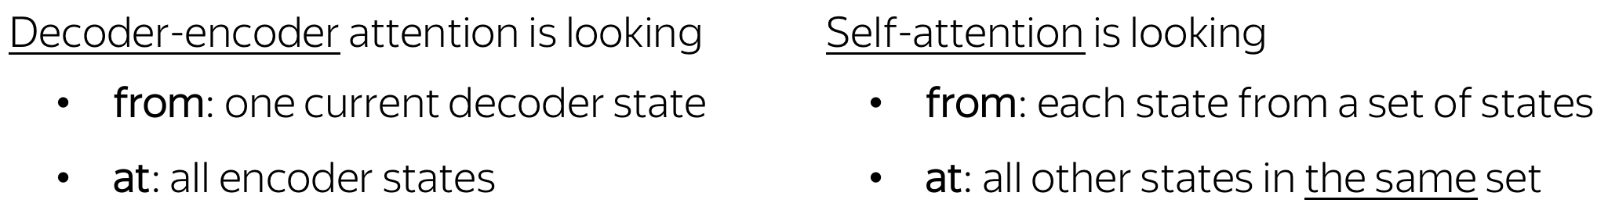
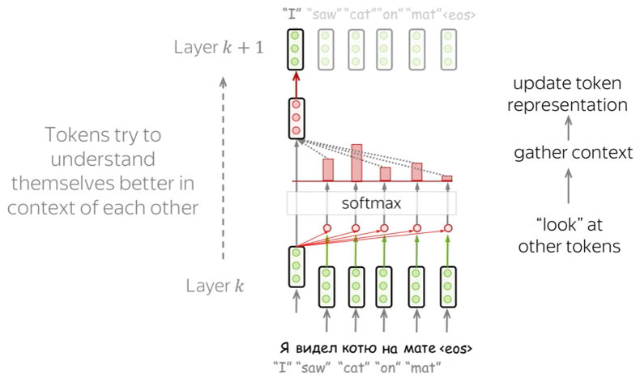
Self attention

Slide 12
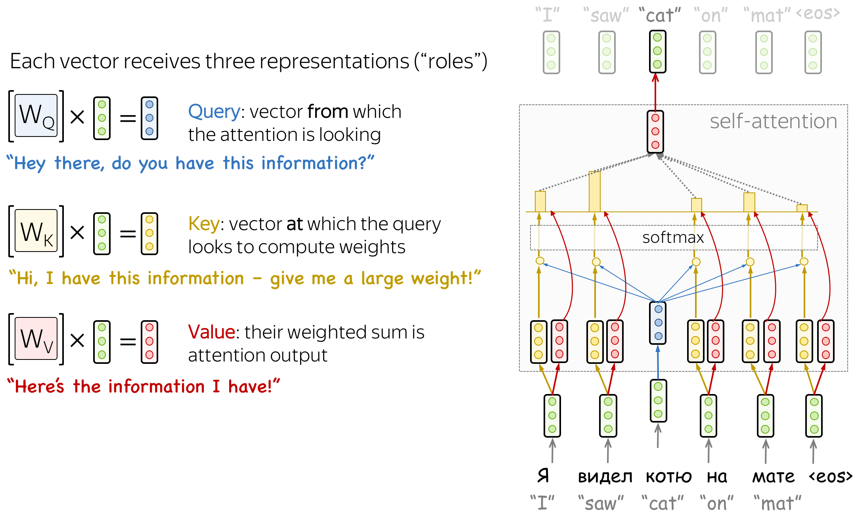
Query, key and value

Slide 13
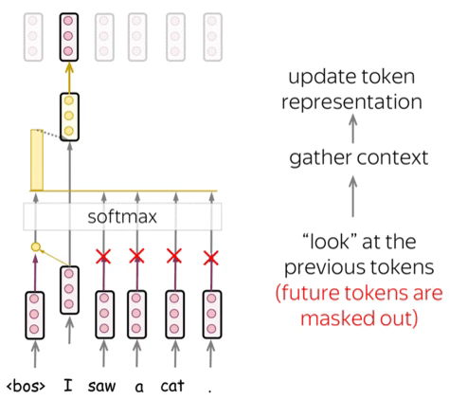
Masked self attention (decoder)

Slide 14
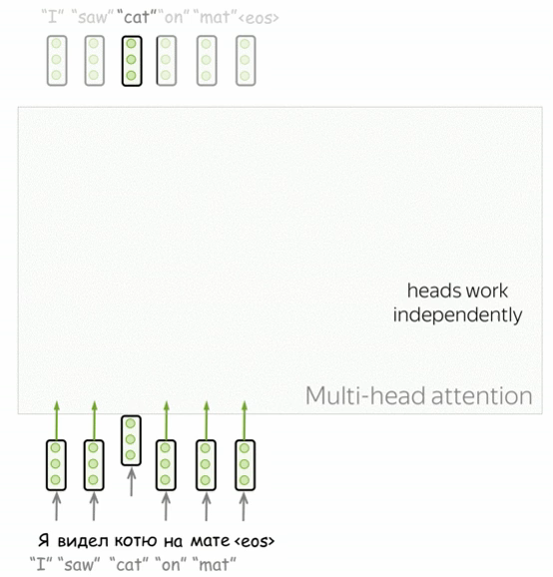
Multi-head attention

Slide 15
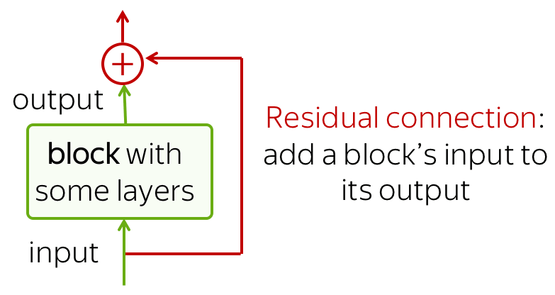
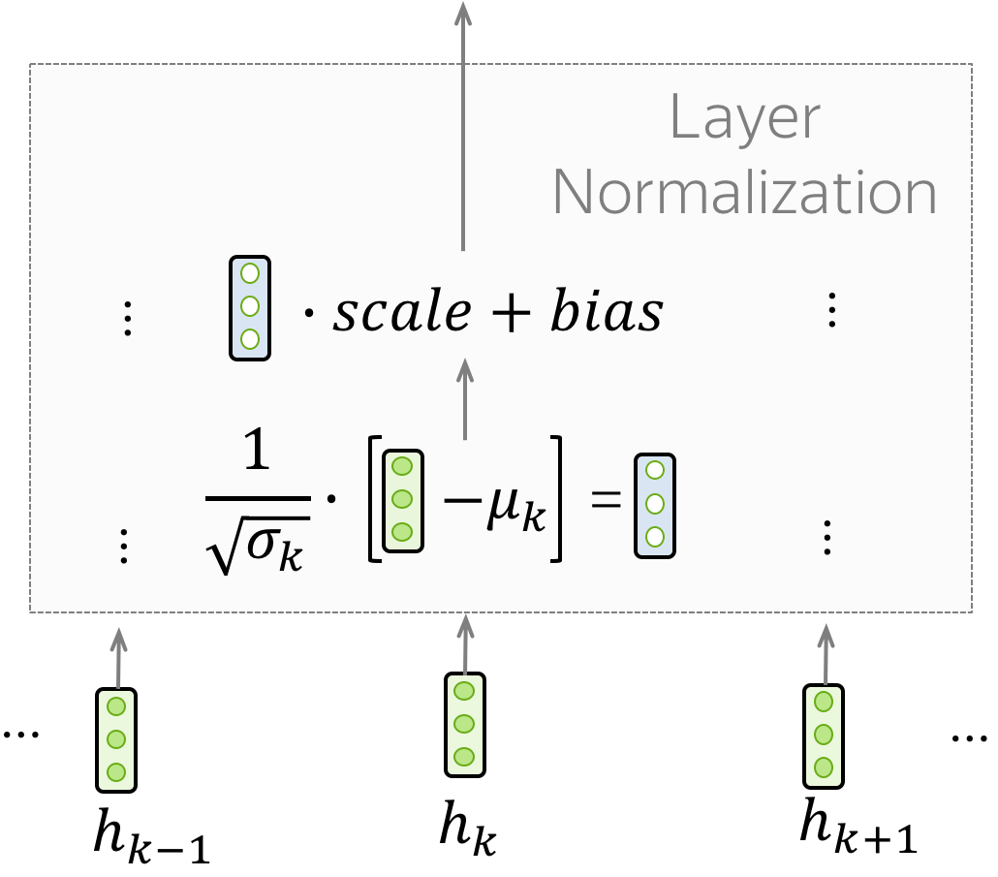
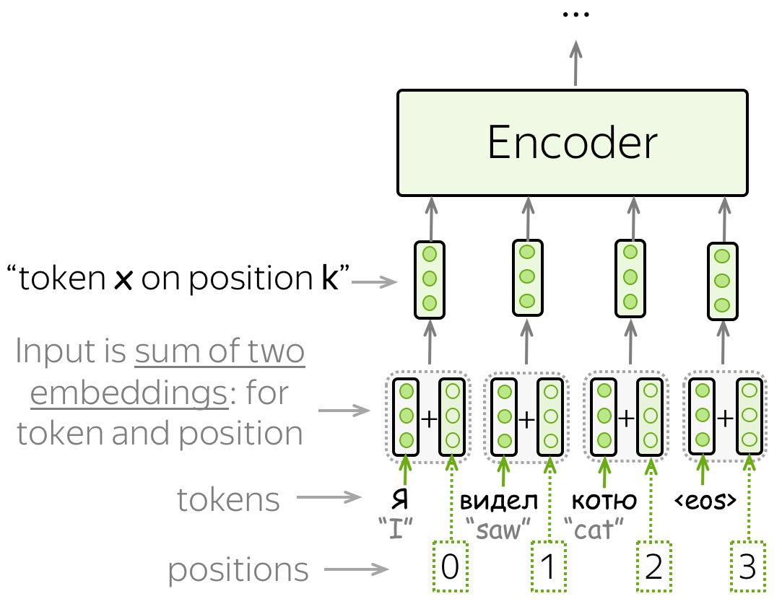

Other ingredients
Residual connections
Layer Normalization
Positional encoding

Slide 16
Practice
Word embedding with skip gram
Word embedding with glove
Sentiment analysis using RNN/CNN
Modules in transformer
Machine translation with transformer

